Slide 1

Setting up your optimization problem
Gradient Checking
deeplearning.ai

Slide 2
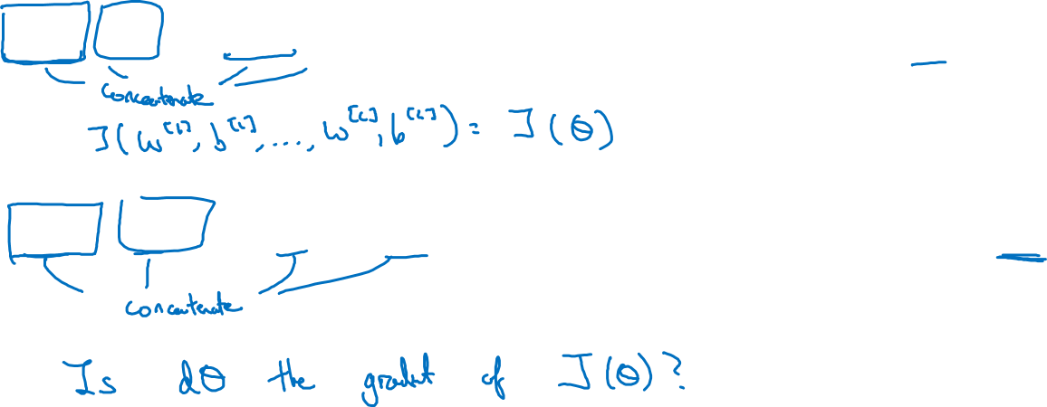
Gradient check for a neural network

Slide 3
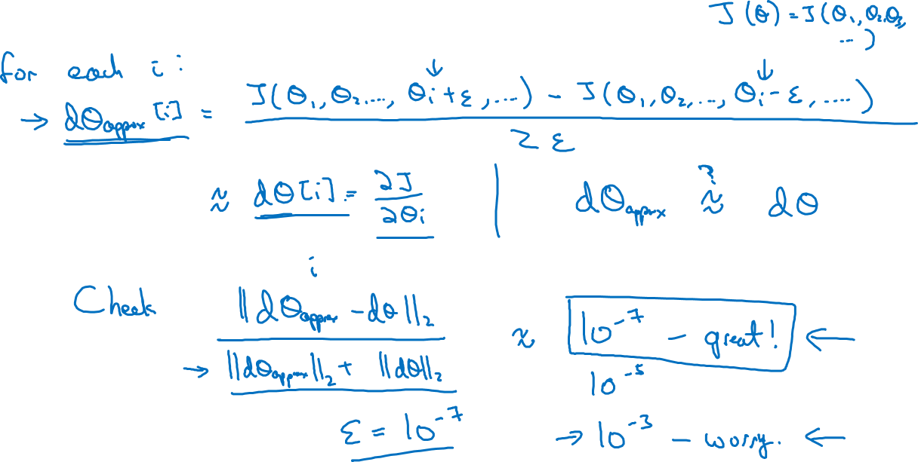
Gradient checking (Grad check)

Slide 4
Setting up your optimization problem
Gradient Checking
implementation notes
deeplearning.ai

Slide 5
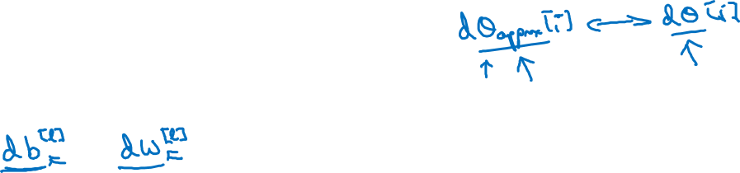
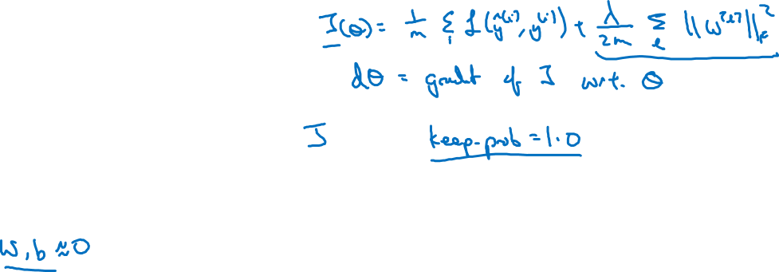
Gradient checking implementation notes
- Don’t use in training – only to debug
- If algorithm fails grad check, look at components to try to identify bug.
- Remember regularization.
- Doesn’t work with dropout.
- Run at random initialization; perhaps again after some training.

